Slide 1



செம்மொழி களஞ்சியம்(Classical Language repository)
AR`ed
TAMIL
Vocabulary
PSID:
TYCH55
THEME:
Learning Education and Schooling

Slide 2
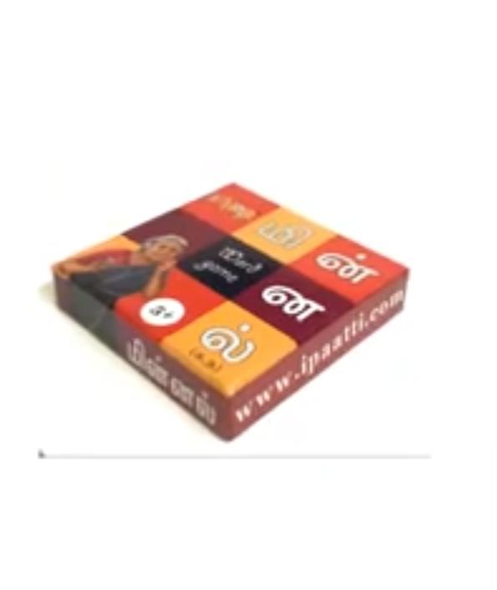
ABOUT YOUR TOY IDEA
An exciting digital toy that helps learner to develop their vocabulary through Augmented reality with fun element in our State language(Tamil).
Overview of Idea
Your Approach towards Idea
Development
Schema Select
To help the learners develop their vocabulary through an exciting technology Augmented Reality .
1
Digital Toy
Developing a Digital toy with the help of Augmented Reality through crossword puzzle
Interactive games with audio element which increases vocabulary and creative learning.
Unity3D and Vuforia will be used for development purpose.
Learning , Education and schooling
2

Slide 3
Our Toy
1
How Your Toy is Different From Existing Toys
Our Toy is mainly focused on improving the involvement among the younger generation over studying our Language(Tamil).
To Add more spice , We have included an exciting technology "Augmented reality“.
The combination of our Traditional state Language and AR Technology will increase the anxious among the younger generation
To make the language more interesting and increase our Language-debit ,we have included many brainstorming puzzles and games which make our toy different from existing toy.

Slide 4
2
Does Your Toy Reflect Indian Culture, Ethos, Ayurveda, Diversity or Psychology
Our toy reflects the psychological aspects and enhance our Indian culture.
Our Indian culture is heavily influenced by different Languages And Tamil plays very important role that it is one of our classical language.
We have developed a toy to restore the Language’s Ethos.
This digital toy is developed to provoke our younger generation’s interest towards our Traditional Language.
This also helps to save our language from extinction and makes our children to Enrich the language.
Our Digital toy reflects the Pshychological aspects of inferiority complex including disliking for grammar and problems in spelling and identifying sounds.
Dyslexia (வாசிப்புக் குறைபாடு)is a learning disorder that involves difficulty reading due to problems identifying speech sounds and learning how they relate to letters and words (decoding). Also called reading disability, dyslexia affects areas of the brain that process language.

Slide 5

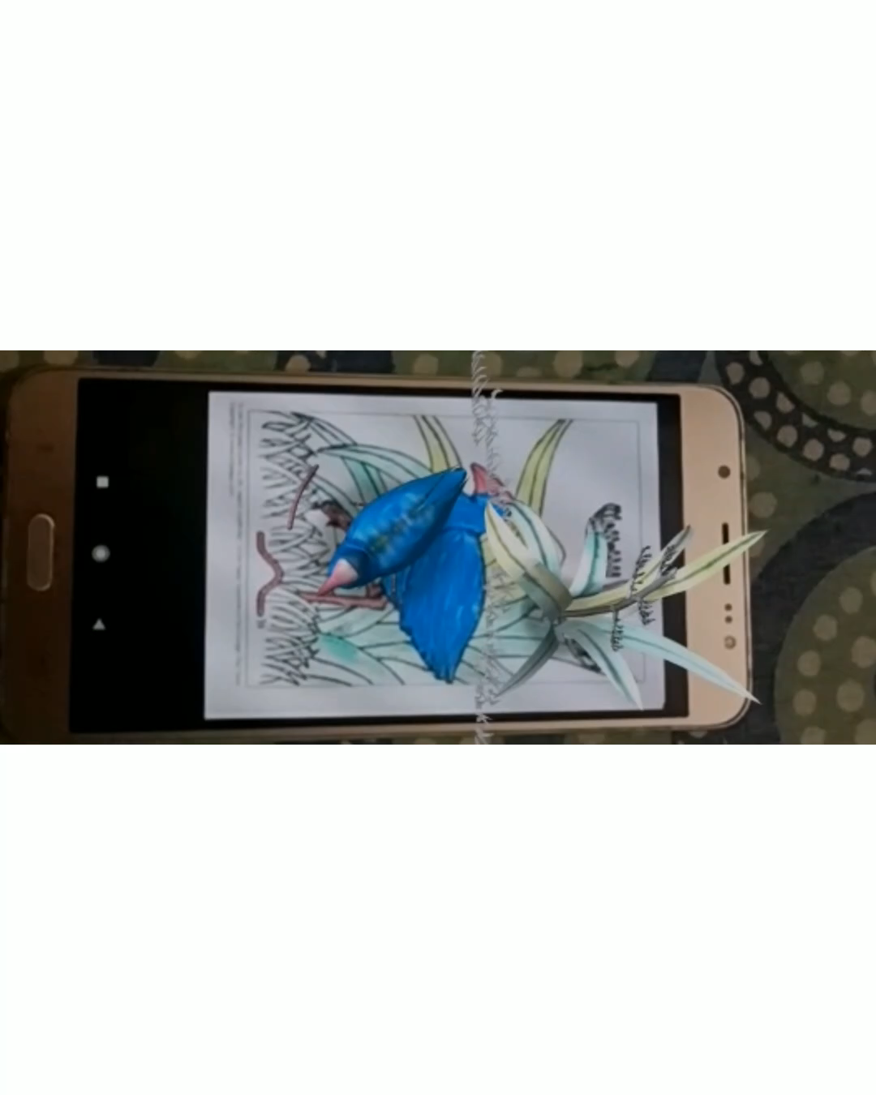
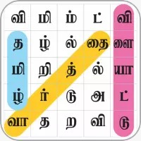
Playing with our app

Slide 6
Team Profile
Team Objective:
Developing a Augmented Reality Mobile App interactive games with audio element which increases vocabulary and creative learning.
SANVI_SIET
Team Details
Team Members:
K . S. Vishnu Priya
vishnupriyaks552000@gmail.com
9489872760
M . Vikasini
vikasini02@gmail.com
8940274301
L . P. Vishalini
vishalinilp2000@gmail.com
9488846992
R . Sanjana
sanram292001@gmail.com
9080224984
Team Size - 4
Mentors - 2
College/Organization – Sri Shakthi Institute of Engineering and Technology
Type - Digital
TEAM MENTORS
S.Hemalatha – hemalatha@siet.ac.in
S. Nivedha - snivedhacse@siet.ac.in

